Slide 1
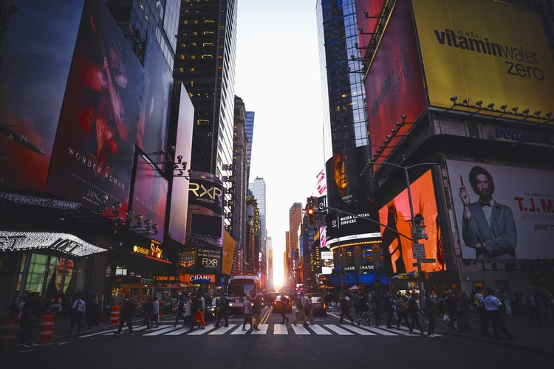
Capstone Project
26 March 2020
IBM Professional Certificate

Slide 2

Introduction
The City of New York, is the most populous city in the United States. It is diverse and is the financial capital of USA. It is multicultural. It provides lot of business opportunities and business friendly environment. It has attracted many different players into the market. It is a global hub of business and commerce. The city is a major center for banking and finance, retailing, world trade, transportation, tourism, real estate, new media, traditional media, advertising, legal services, accountancy, insurance, theater, fashion, and the arts in the United States.

Slide 3
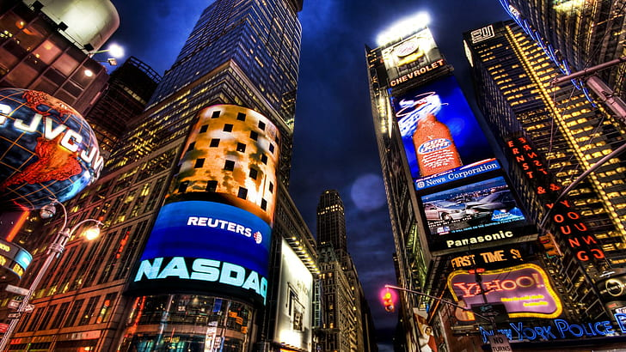
This also means that the market is highly competitive. As it is highly developed city so cost of doing business is also one of the highest. Thus, any new business venture or expansion needs to be analyzed carefully. The insights derived from analysis will give good understanding of the business environment which help in strategically targeting the market. This will help in reduction of risk. And the Return on Investment will be reasonable.

Slide 4
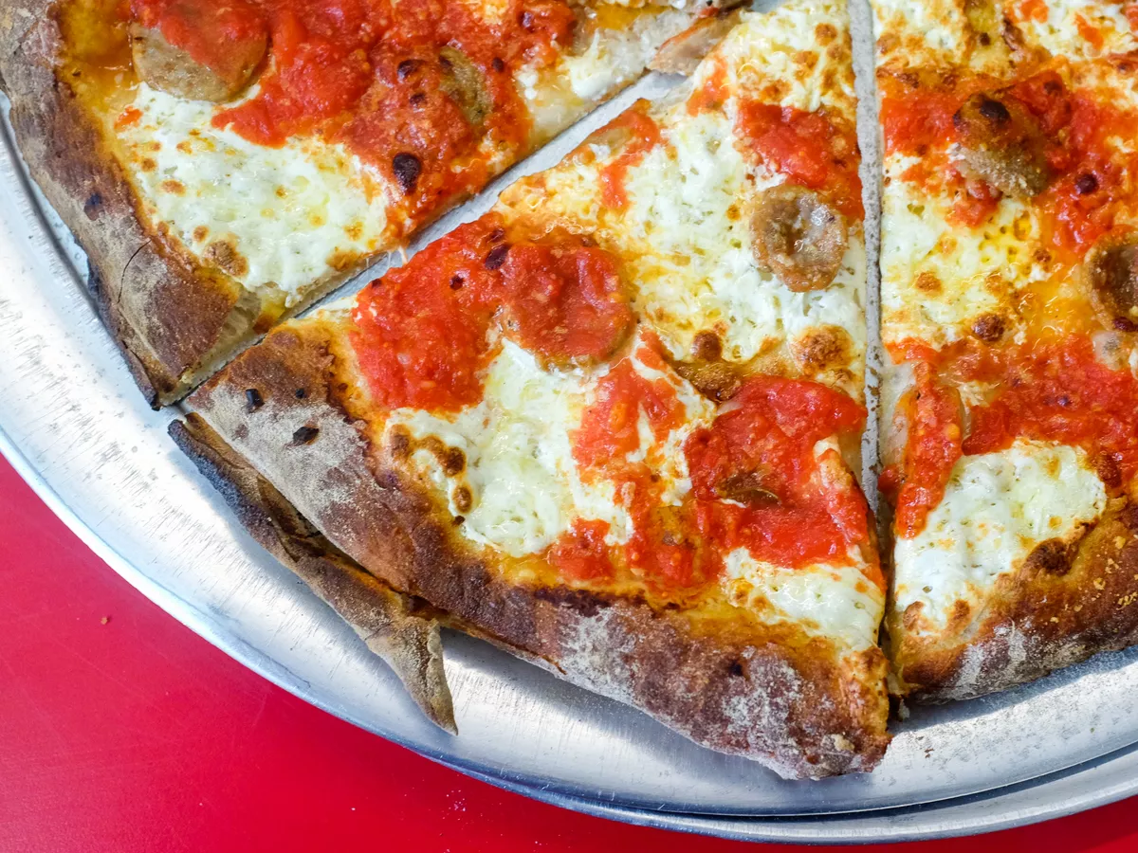
Business Problem
The City of New York is famous for its excellent cuisine. It's food culture includes an array of international cuisines influenced by the city's immigrant history. Sushi restaurants have become so popular in the United States now it seems that there is one on every corner, not only in major cities but also in smaller cities. Starting a sushi restaurant can be a great business opportunity, but you need to distinguish yourself from others to enjoy long-term success.

Slide 5
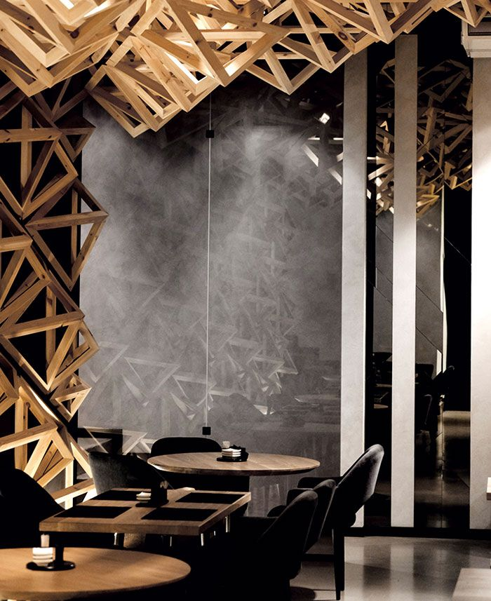
My client wants to open his business in Manhattan area, so I focus on that borough during my analysis. We define potential neighborhood based on the number of sushi bars which are operating right in each neighborhood. Manhattan has full potential but also is a very challenging district to open a business because of high competition. New sushi bar should be open in an area that inadequate neighborhood in this way the bar can attract more customers. Therefore, this analysis necessary to ensure that we have enough customers and that we are not so close to other sushi places.

Slide 6
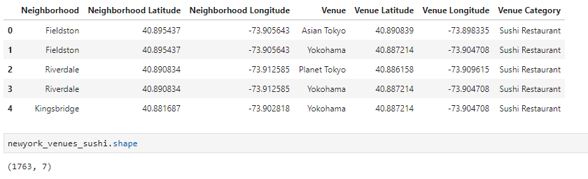
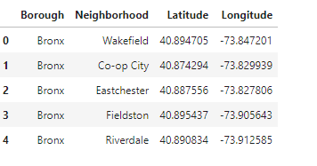
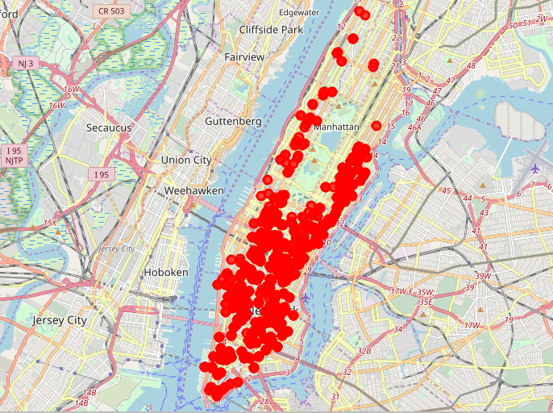
Above, I have done convert addresses into their equivalent latitude and longitude values. Then we will use the Foursquare API to explore neighborhoods in Manhattan, New York. After that, explore function to get sushi restaurant categories in each neighborhood.

Slide 7
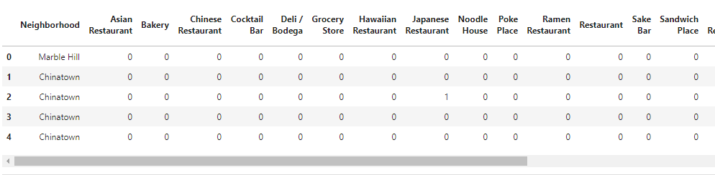
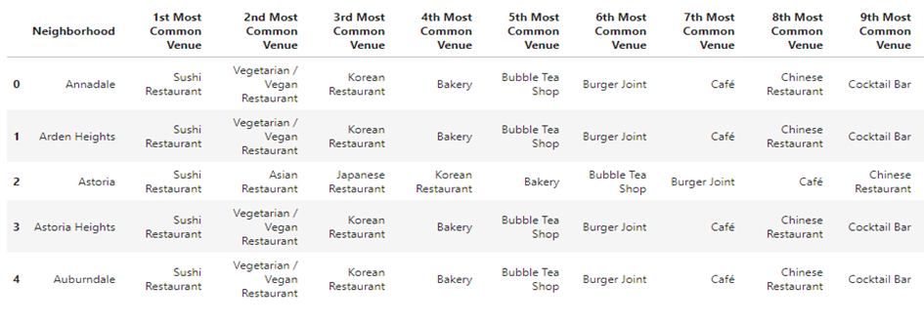
Then use this feature to group the neighborhoods into clusters K-means clustering algorithm will be use to complete this task. And also, the Folium library to visualize the neighborhoods in Manhattan and its emerging clusters.

Slide 8
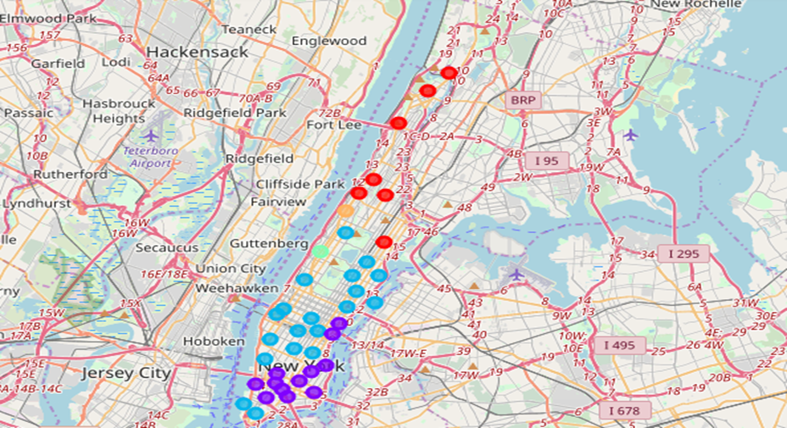

Slide 9
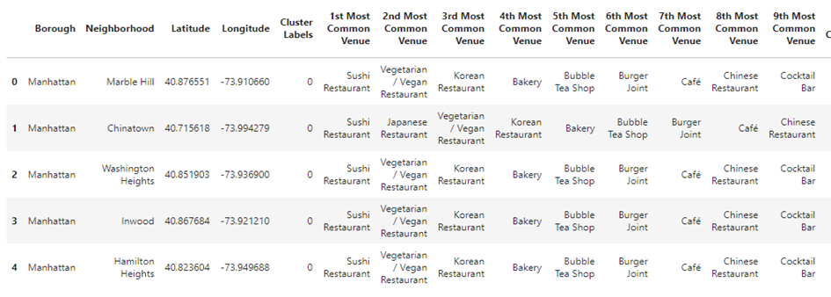
Results
K-mean Cluster Using K-mean to clustering data area with less number of sushi bars
Cluster 0

Slide 10
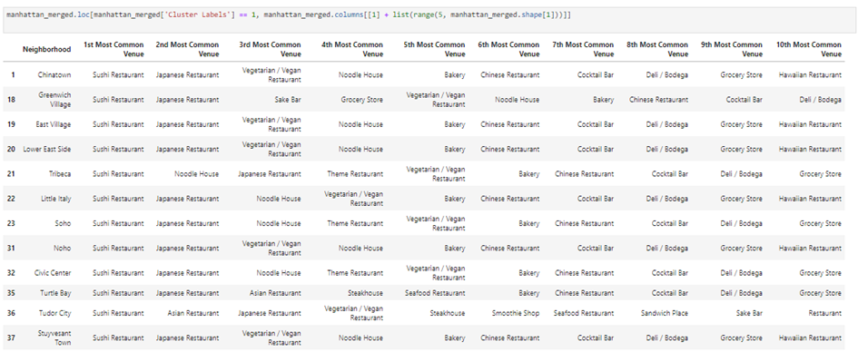
Cluster 1

Slide 11
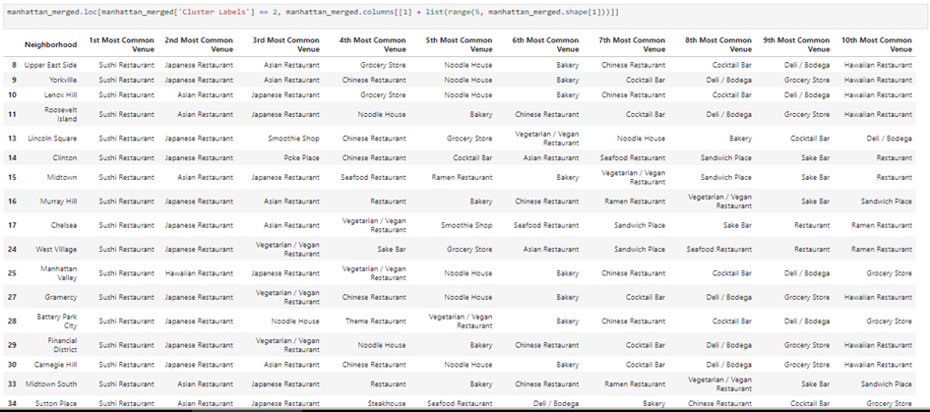
Cluster 2

Slide 12
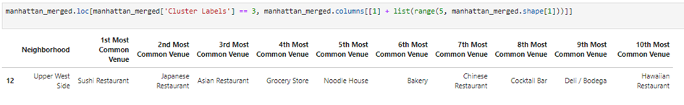
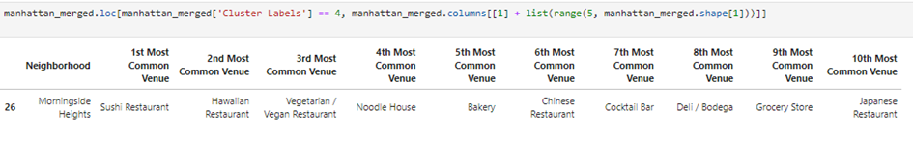
Cluster 3
Cluster 4

Slide 13
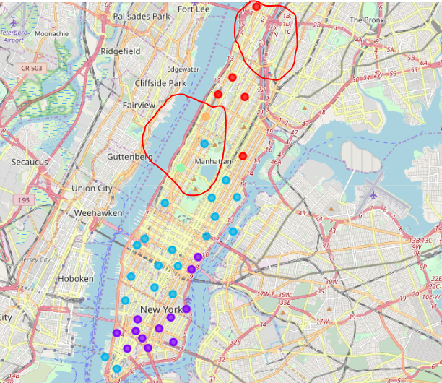
Based on dataframe analysis above Cluster 3 (Upper West Side ) and Cluster 4 (Morningside Heights) areas are the best places to open a new sushi bar business.

Slide 14

Conclusion
Although all of the goals of this project were met there is definitely room for further improvement and development as noted below. However, the goals of the project were met and, with some more work, could easily be developed into a fully fledged application that could support the opening a business idea in an unknown location.
As per the neighborhood or restaurant type mentioned like Sushi restaurants analysis can be checked. A venue with lowest risk and competition can be identified.

